Slide 1
December 2022
Autonomous Underwater Vehicle (auv) guidance digital control
ALEX KHAIR AND JUSTIN HART
The University of Texas at Austin

Slide 2
OVERVIEW
Introduction
Objectives
Equation of Motion/State Space Representation
Inputs/Controllability
Emulation/Block Diagram
Results
Conclusions
Future Work
2

Slide 3
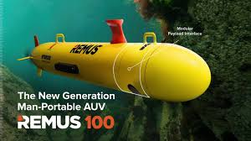
INTRODUCTION
AUVs are unmanned underwater robots that operate independently from humans
Industries served – oil and gas, defense, oceanographic research/exploration
Research under work → experimenting with different models/controllers to find best solution
3

Slide 4
OBJECTIVES
Replicate and study trajectory tracking of an AUV
Derive 6 DOF plant model
Utilize PID controllers to control the 3 controllable inputs to the AUV
Emulate the system (controllers + plant) in the discrete time
Investigate system performance qualitatively
Sampling rate effect on stability
Ability to track different trajectories
Robustness against different disturbances
4

Slide 5
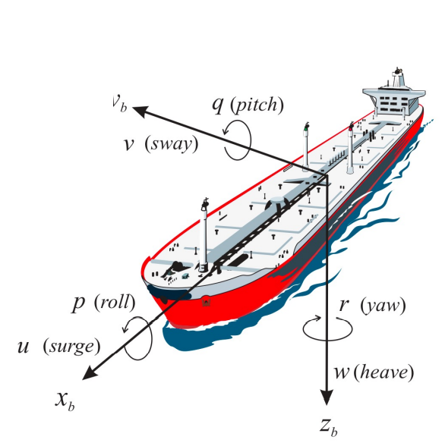
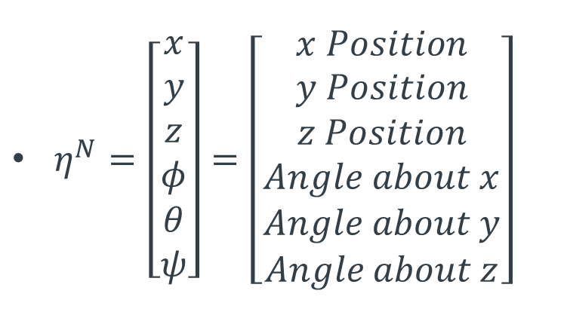
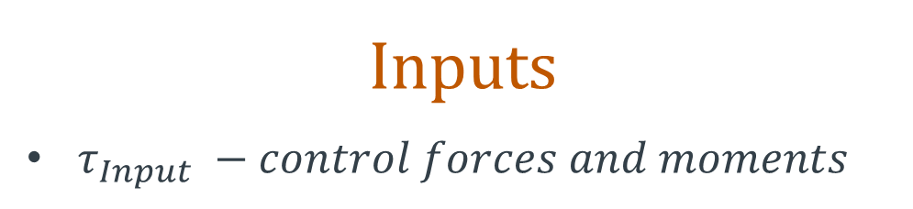
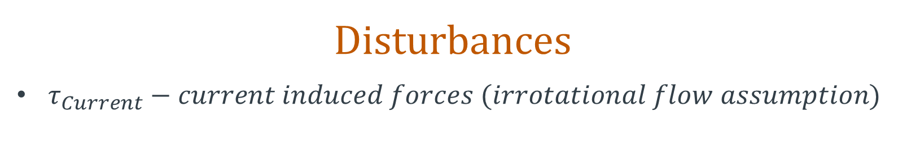
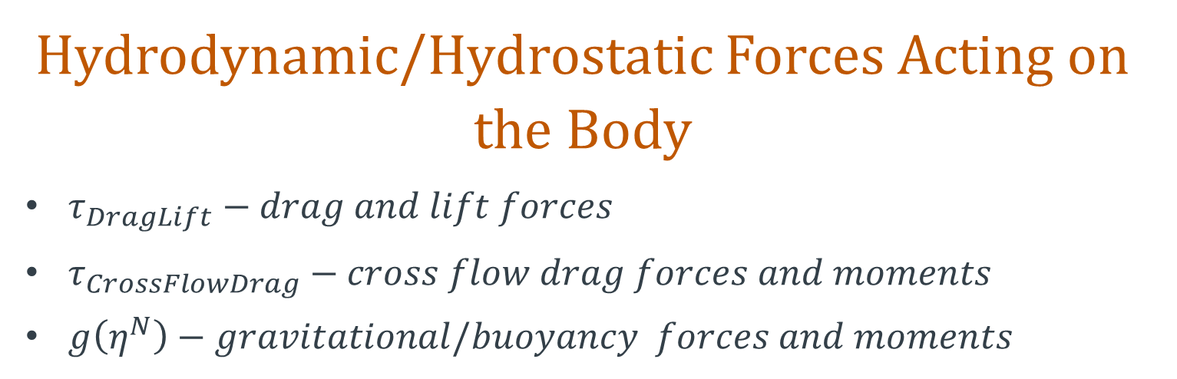
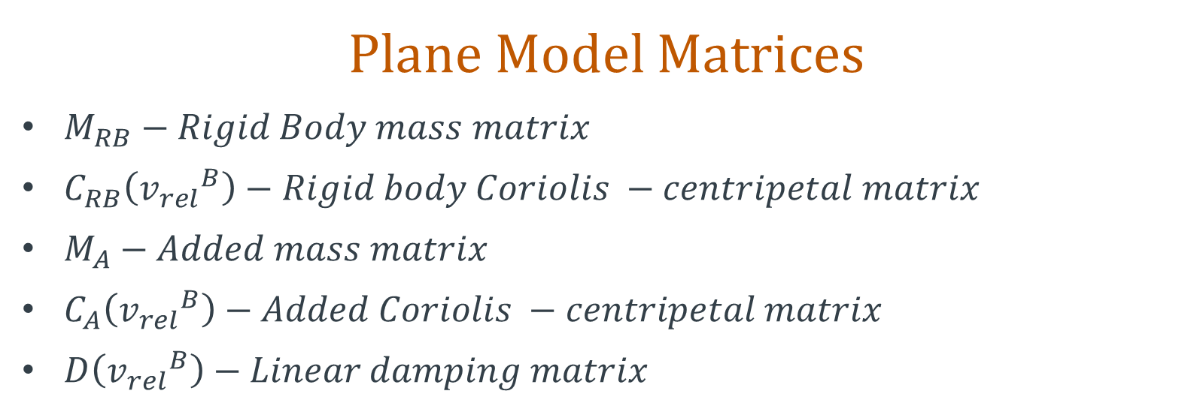
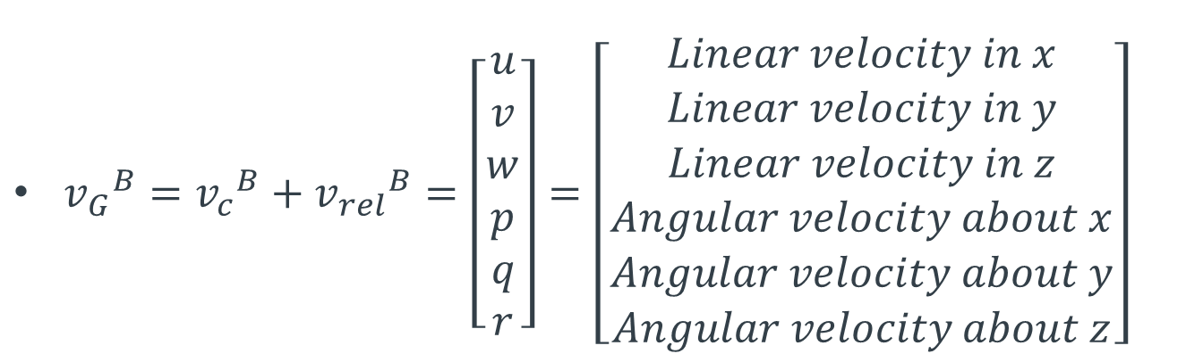
Equations Of Motion
$$M_{RB}{{\dot{v}}_{G}}^{B}+C_{RB}\left({v_{G}}^{B}\right){v_{G}}^{B}+M_{A}{{\dot{v}}_{rel}}^{B}+C_{A}\left({v_{rel}}^{B}\right){v_{rel}}^{B}+D\left({v_{rel}}^{B}\right){v_{rel}}^{B}+g\left(η^{N}\right)=τ_{Input}+τ_{Current}+τ_{DragLift}+τ_{CrossFlowDrag}$$
Plane Model Matrices
$M_{RB}−Rigid Body mass matrix$
$C_{RB}\left({v_{rel}}^{B}\right)−Rigid body Coriolis −centripetal matrix$
$M_{A}−Added mass matrix$
$C_{A}\left({v_{rel}}^{B}\right)−Added Coriolis −centripetal matrix$
$D\left({v_{rel}}^{B}\right)−Linear damping matrix$
States
$η^{N}=\left[\begin{matrix}x \\ y \\ z \\ φ \\ θ \\ ψ\end{matrix}\right]=\left[\begin{matrix}x Position \\ y Position \\ z Position \\ Angle about x \\ Angle about y \\ Angle about z\end{matrix}\right]$
${v_{G}}^{B}={v_{c}}^{B}+{v_{rel}}^{B}=\left[\begin{matrix}u \\ v \\ w \\ p \\ q \\ r\end{matrix}\right]=\left[\begin{matrix}Linear velocity in x \\ Linear velocity in y \\ Linear velocity in z \\ Angular velocity about x \\ Angular velocity about y \\ Angular velocity about z\end{matrix}\right]$
Inputs
$τ_{Input} −control forces and moments$
Hydrodynamic/Hydrostatic Forces Acting on the Body
$τ_{DragLift}−drag and lift forces$
$τ_{CrossFlowDrag}−cross flow drag forces and moments$
$g\left(η^{N}\right)−gravitational/buoyancy forces and moments$
Disturbances
$τ_{Current}−current induced forces (irrotational flow assumption)$
5

Slide 6
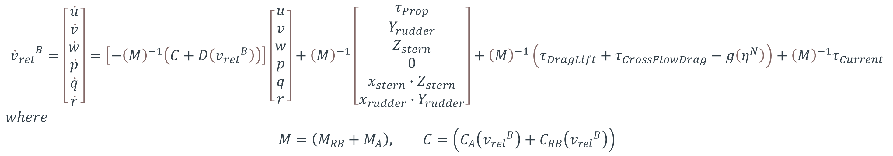

Nonlinear State Space Representation
The 6 DOF plant model allows for 12 states: the 6 velocities (3 linear and 3 angular) and 6 positions (3 cartesian coordinates and 3 angles)
$${{\dot{v}}_{rel}}^{B}=\left[\begin{matrix}\dot{u} \\ \dot{v} \\ \dot{w} \\ \dot{p} \\ \dot{q} \\ \dot{r}\end{matrix}\right]=\left[−{\left(M\right)}^{−1}\left(C+D\left({v_{rel}}^{B}\right)\right)\right]\left[\begin{matrix}u \\ v \\ w \\ p \\ q \\ r\end{matrix}\right]+{\left(M\right)}^{−1}\left[\begin{matrix}τ_{Prop} \\ Y_{rudder} \\ Z_{stern} \\ 0 \\ x_{stern}∙Z_{stern} \\ x_{rudder}∙Y_{rudder}\end{matrix}\right]+{\left(M\right)}^{−1}\left(τ_{DragLift}+τ_{CrossFlowDrag}−g\left(η^{N}\right)\right)+{\left(M\right)}^{−1}τ_{Current}$$
$$where$$
$$M=\left(M_{RB}+M_{A}\right), C=\left(C_{A}\left({v_{rel}}^{B}\right)+C_{RB}\left({v_{rel}}^{B}\right)\right)$$
Coordinate Frame Transformations
$${{\dot{v}}_{G}}^{B}={\dot{v_{c}}}^{B}+{{\dot{v}}_{rel}}^{B}=−S\left(ω_{B/N}^{B}\right){v_{c}}^{B}+{{\dot{v}}_{rel}}^{B}, {v_{G}}^{N}=\left[\begin{matrix}R_{B}^{N} & 0_{3x3} \\ 0_{3x3} & {\left(T_{N}^{B}\right)}^{−1}\end{matrix}\right]{v_{G}}^{B}$$
Overall State Equation
$$\left[\begin{matrix}{{\dot{v}}_{G}}^{B} \\ {\dot{η}}^{N}\end{matrix}\right]=\left[\begin{matrix}−S\left(ω_{B/N}^{B}\right){v_{c}}^{B} \\ 0_{6x1}\end{matrix}\right]+\left[\begin{matrix}{{\dot{v}}_{rel}}^{B} \\ 0_{6x1}\end{matrix}\right]+\left[\begin{matrix}0_{6x6} & 0_{6x6} \\ \left[\begin{matrix}R_{B}^{N} & 0_{3x3} \\ 0_{3x3} & {\left(T_{N}^{B}\right)}^{−1}\end{matrix}\right] & 0_{6x6}\end{matrix}\right]\left[\begin{matrix}{v_{G}}^{B} \\ η^{N}\end{matrix}\right]$$
6

Slide 7
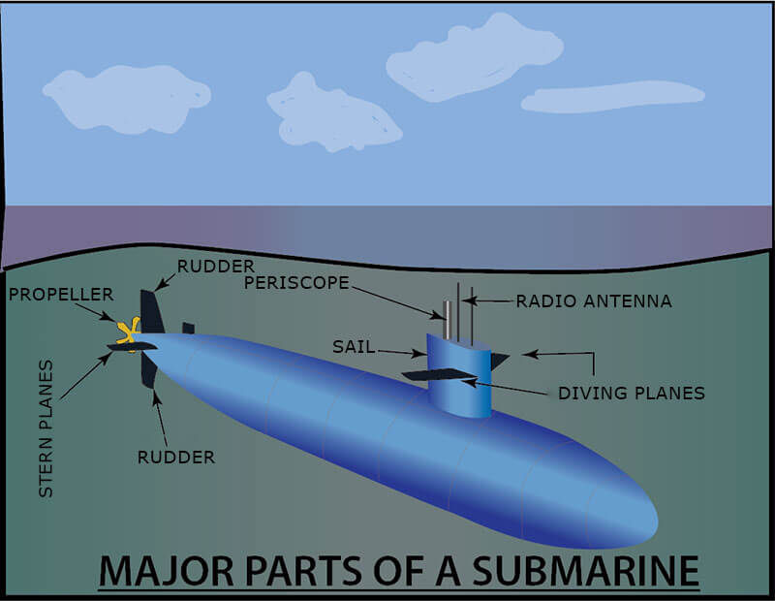
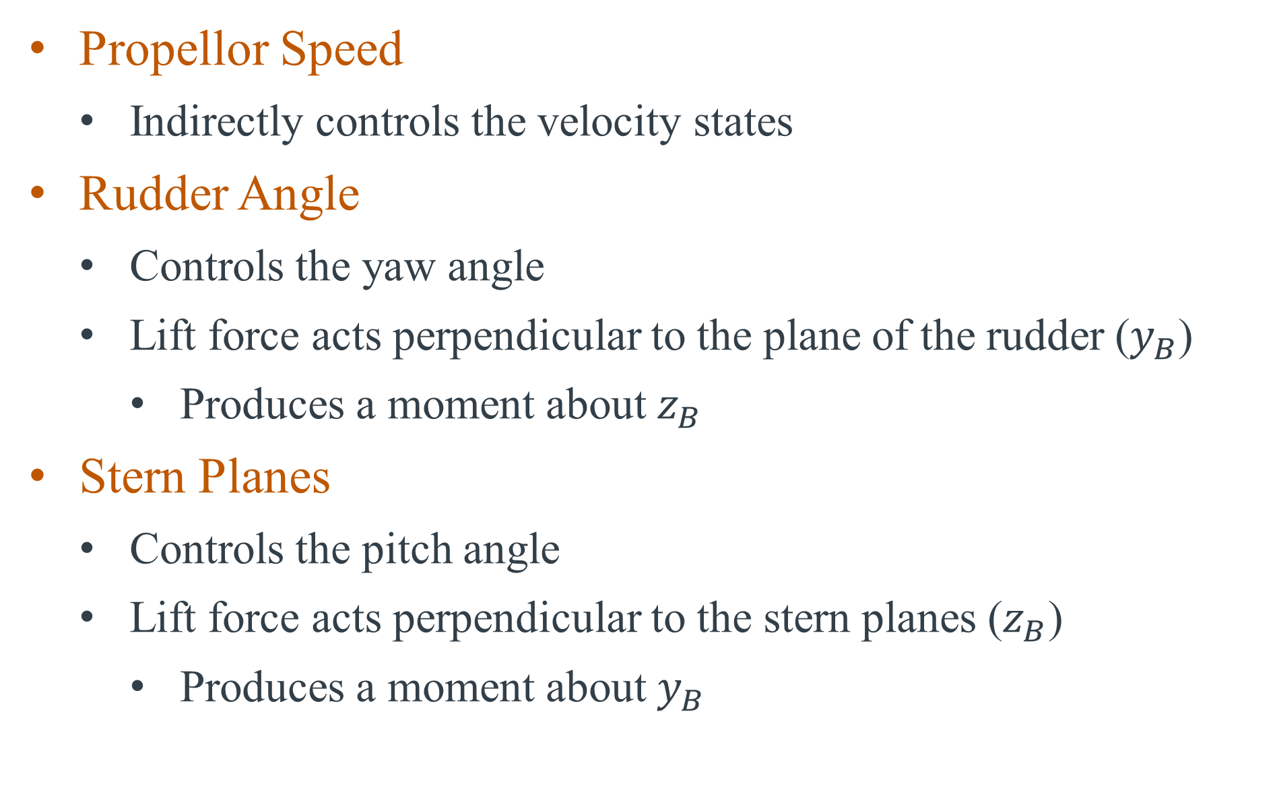
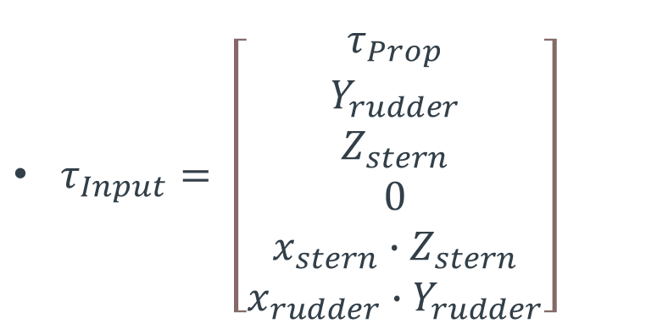



Inputs/Controllability
$τ_{Input}= \left[\begin{matrix}τ_{Prop} \\ Y_{rudder} \\ Z_{stern} \\ 0 \\ x_{stern}∙Z_{stern} \\ x_{rudder}∙Y_{rudder}\end{matrix}\right]$
$$x_{B}$$
$$y_{B}$$
$$z_{B}$$
Propellor Speed
Indirectly controls the velocity states
Rudder Angle
Controls the yaw angle
Lift force acts perpendicular to the plane of the rudder ($y_{B}$)
Produces a moment about $z_{B}$
Stern Planes
Controls the pitch angle
Lift force acts perpendicular to the stern planes ($z_{B}$)
Produces a moment about $y_{B}$
$$ℂ=\left[\begin{matrix}B & AB & A^{2}B & ⋯ & A^{12}B\end{matrix}\right]$$
System isn’t fully controllable
12 states
5 non-zero inputs to the system
3 controllable inputs
No control over roll
7

Slide 8
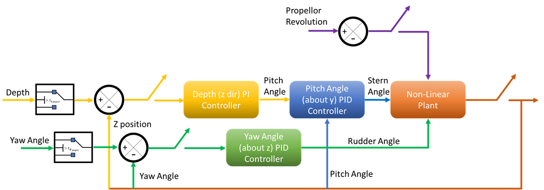
Block Diagram
8

Slide 9
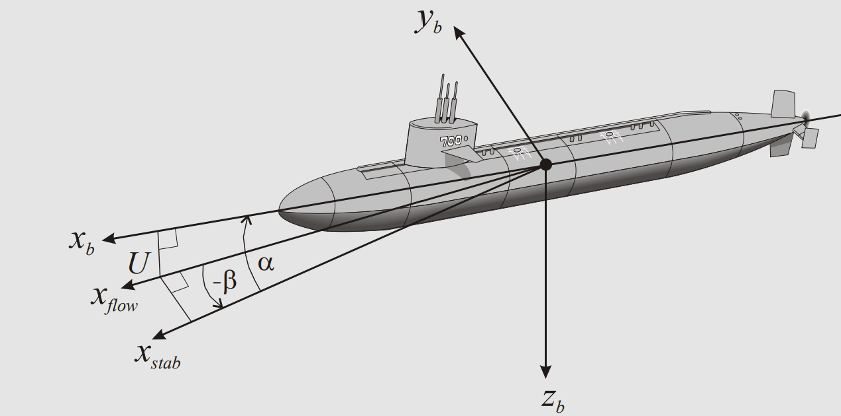
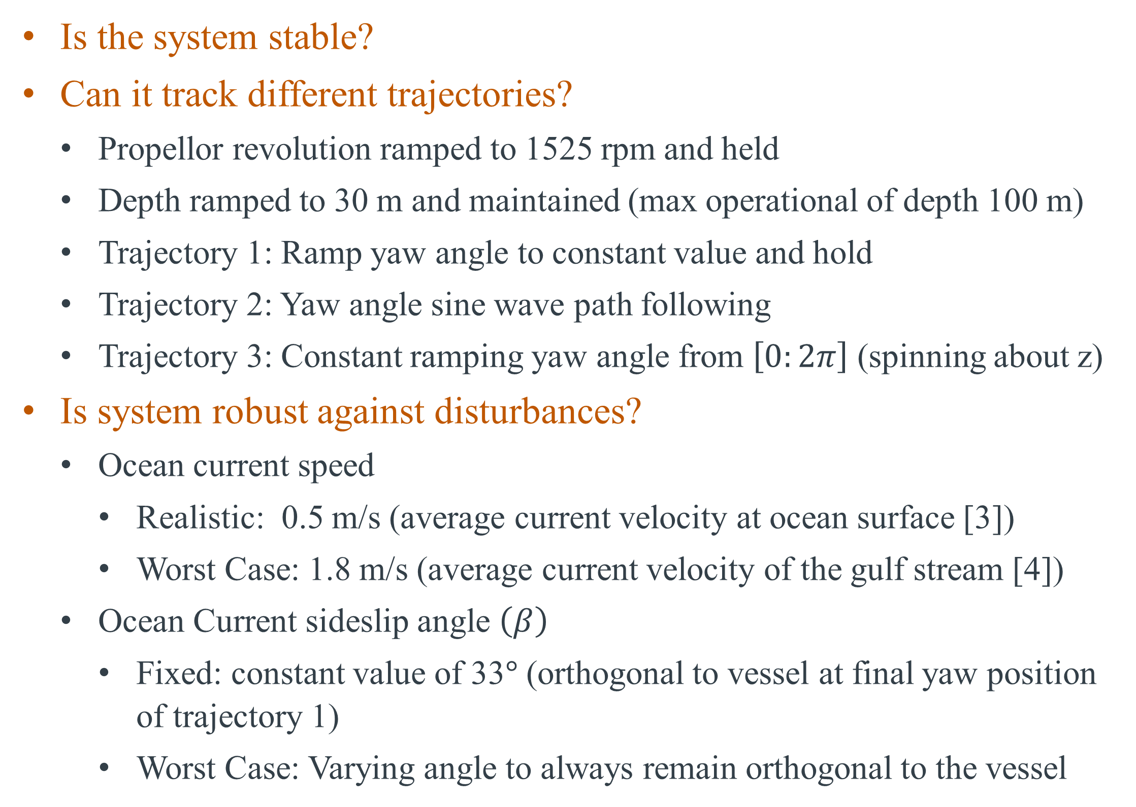
Performance Metrics
Is the system stable?
Can it track different trajectories?
Propellor revolution ramped to 1525 rpm and held
Depth ramped to 30 m and maintained (max operational of depth 100 m)
Trajectory 1: Ramp yaw angle to constant value and hold
Trajectory 2: Yaw angle sine wave path following
Trajectory 3: Constant ramping yaw angle from $\left[0:2π\right]$ (spinning about z)
Is system robust against disturbances?
Ocean current speed
Realistic: 0.5 m/s (average current velocity at ocean surface [3])
Worst Case: 1.8 m/s (average current velocity of the gulf stream [4])
Ocean Current sideslip angle $\left(β\right)$
Fixed: constant value of 33$°$ (orthogonal to vessel at final yaw position of trajectory 1)
Worst Case: Varying angle to always remain orthogonal to the vessel
Sideslip angle Beta [1]
9

Slide 10
Results: Sampling Time Analysis
Criteria
Computational efficient (reasonable run time)
Stable
Identified through guess/check tuning
Ideal sampling time of .05 seconds
Instability arises at sampling time of .15 seconds
T = 0.05s (20Hz)
T = 0.15s (6.67Hz)
10

Slide 11
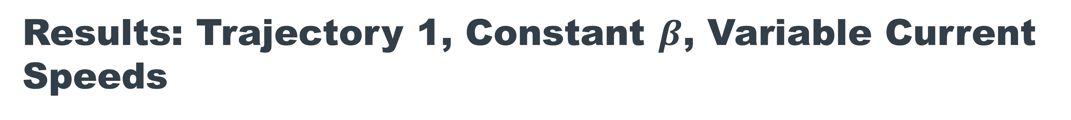
Results: Trajectory 1, Constant $β$, Variable Current Speeds
Reasonable Current (.5 m/s)
Fast Current (1.8 m/s)
11

Slide 12
Results: Trajectory 1, Continued
Plant Inputs
Velocity States
Reasonable Current (.5 m/s)
Fast Current (1.8 m/s)
12

Slide 13
Results: Trajectory 2, Constant $β$, Fast Current
Position/Angle States
Plant Inputs
Note controller failed to track worst case $β$ angle
13

Slide 14
Results: Trajectory 3, Constant $β$, Fast Current
Position/Angle States
Plant Inputs
Note controller failed to track worst case $β$ angle
14

Slide 15
Results: Density Parameter Study
Nonuniform Density
Uniform Density
15

Slide 16
CONCLUSIONS
Successfully rederived a 6 DOF, realistic, nonlinear plant model for an AUV
Represented the model in terms of nonlinear state equations
Reduced the second order system to a first order system
Emulated the model using ODE45 function in MATLAB
Demonstrated ability to track reference profiles for all 3 controllable inputs using discrete time PID controllers
Inputs were moved sequentially
Capable of tracking various yaw angle trajectories
Demonstrated robustness of the system against various disturbances
Evaluated tracking capability for different current speeds
Evaluated tracking capability for different horizontal angles of current flow
16

Slide 17
FUTURE WORK
Lyapunov stability
Reference [1] has a discussion on this for similar systems
Elaborate upon input profiles/disturbances
Investigate performance when providing inputs concurrently
Define trajectories in terms of cartesian x and y coordinates in the NED frame
Model their relationships to controllable inputs
Evaluate effects of vertical current streams
Dive deeper into the controller model
Investigate adaptive PID coefficients
Investigate optimal control methods
More thorough parameter study
Define quantitative performance metrics
17

Slide 18
QUESTIONS?
18

Slide 19
References
[1] Fossen, T. I. (2021). Handbook of Marine Craft Hydrodynamics and Motion Control (2nd ed.). Wiley.
[2] Imlay, F. H. (1961). The Complete Expressions for Added Mass of a Rigid Body Moving in an Ideal
Fluid. Technical Report DTMB 1528. David Taylor Model Basin. Washington D.C.
[3] “Ocean Current.” Encyclopædia Britannica, Encyclopædia Britannica, Inc., https://www.britannica.com/science/ocean-current.
[4] US Department of Commerce, National Oceanic and Atmospheric Administration. “How Fast Is the Gulf Stream?” NOAA's National Ocean Service, 1 June 2013, https://oceanservice.noaa.gov/facts/gulfstreamspeed.html.
19

